Slide 1
PROPERTY PROTECTION
Home insurance,
made easier
Clarity for homeowners. Control for the teams behind every claim.
A CONNECTED INSURANCE PLATFORM

Slide 2


THE PLATFORM
One platform, two connected experiences
Customers manage protection from home while surveyors and admins manage inspections, claims, and service operations.
Homeowners
Surveyors & admins
See what is covered, what happens next, and where to get help.
Coordinate inspections, claims, users, policies, and service work in one operational view.
A calm customer experience
A connected service experience

Slide 3





THE HOMEOWNER VIEW
Homeowners see their protection at a glance
One calm dashboard brings the essentials together, so people know what is covered and where to turn.
Policy status
Covered property
Active and easy to confirm
The home and its protection
Renewal dates
Documents & support
No important date hidden
Answers close at hand

Slide 4
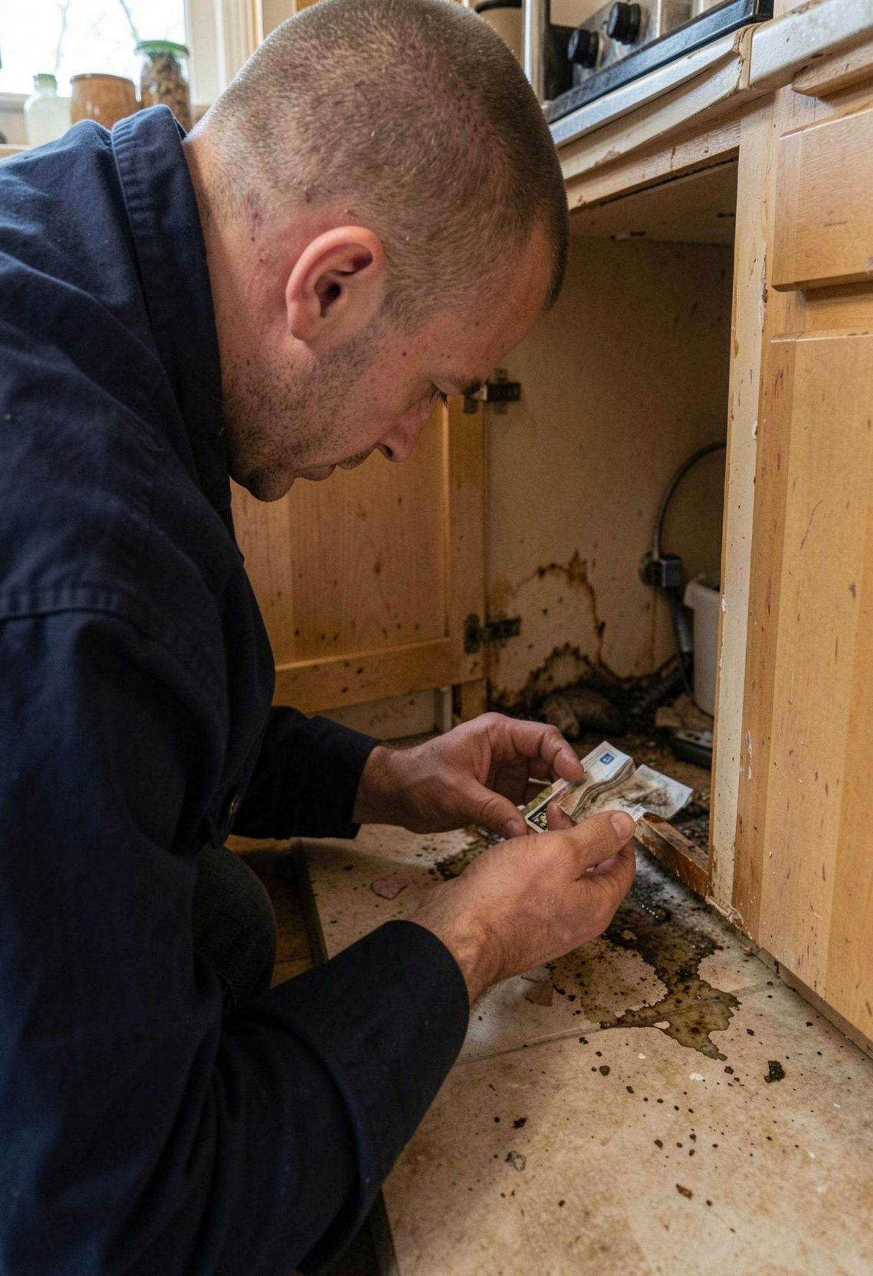
THE CLAIMS JOURNEY
Claims move from incident to resolution
Every stage is visible, from the first report to the settlement decision.
Report: Share photos and details of the incident.
Review: Track review and surveyor assignment.
Resolve: See next steps, updates, and settlement progress.

Slide 5
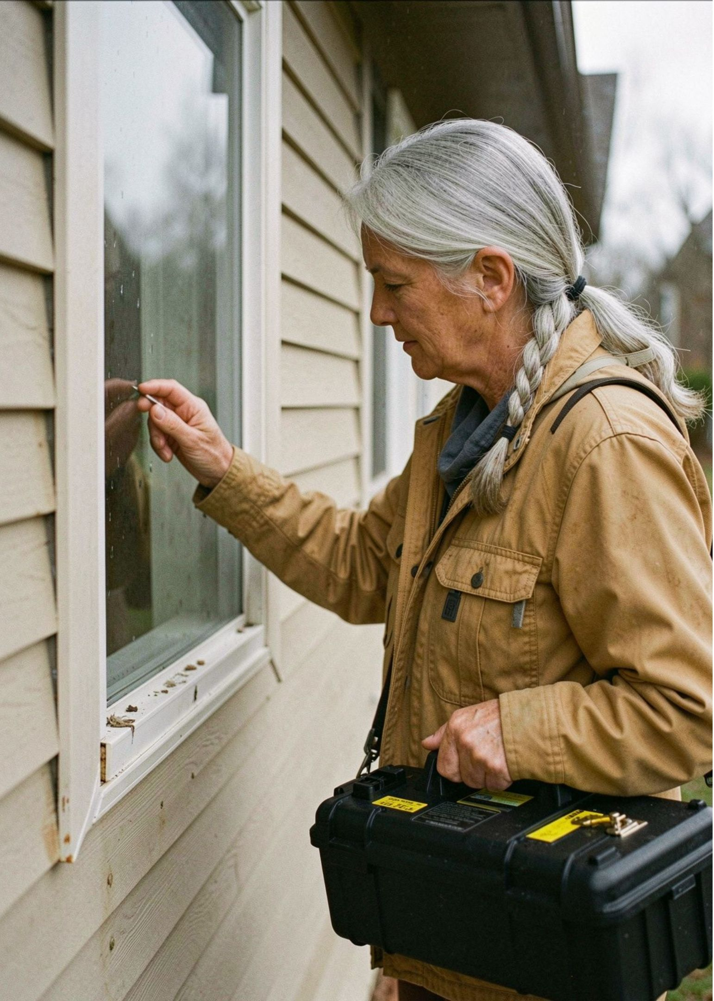




THE FIELD VIEW
Surveyors work from the field
Review assigned cases, schedule visits, capture evidence, complete inspection checklists, and submit findings from any device.
Assigned cases
Schedule visits
Review the queue and plan the day.
Coordinate inspections without back-and-forth.
Capture evidence
Submit findings
Record photos, notes, and inspection details.
Complete checklists and move the case on.

Slide 6
THE OPERATIONS VIEW
Admins keep every case moving
Live operational views make the work visible, so teams can act before a case stalls.
WORKLOADS
PRIORITY
CONTROL
INSIGHT
Open
Urgent
Manage
Spot
See cases by owner, queue, and current stage.
Bring attention to claims that need action now.
Keep users and policies accurate and current.
Find bottlenecks through live operational views.

Slide 7




Fewer status-chasing calls
Clearer communication
THE OUTCOME
Customers can check progress without waiting for an update.
Customer, surveyor, and insurer share the same view.
Trust grows through visible progress
More consistent decisions
Progress people can trust
Documentation and next steps are captured in one place.
A visible path from incident to resolution.
When every handoff is easier to see, confidence replaces uncertainty.

Slide 8
THE NEXT EXPERIENCE
A simpler future
for property protection
Connect customers, surveyors, and admins in one reliable digital experience built around confidence after the unexpected.
PROTECTION PEOPLE CAN UNDERSTAND

